Slide 1
Session 6
GitHub

Slide 2
Tools for Development
ALM/TestRail:
A test case management tool that acts as a repository of manual test cases. Able to do test runs, reports and integration with automation.
Jira:
A project management tool comprised of work units, backlogs, team boards, stories, tickets etc. Entire company uses it.
GitHub/BitBucket:
An online cloud code repository website.
Jenkins:
A cloud code run with headless browser and collaborative report tool.

Slide 3
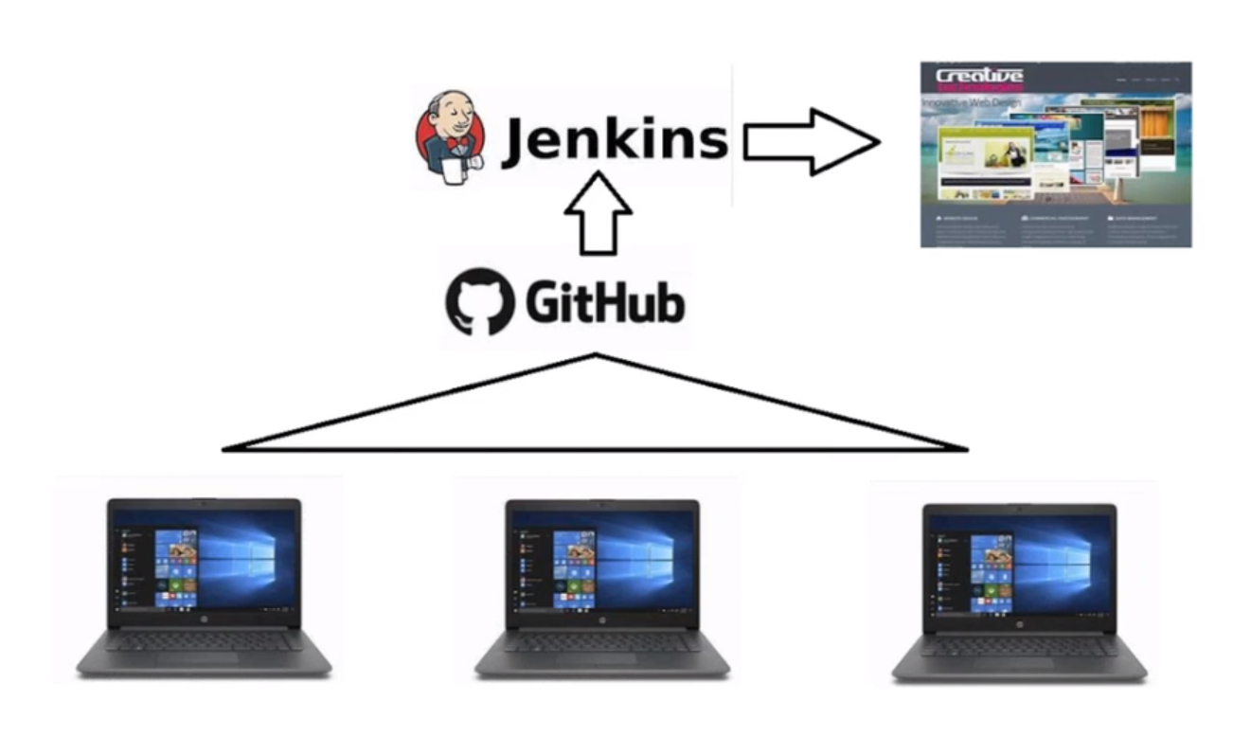

Slide 4
What is GIT
It has a repository or repo to store codes
GIT is a Version Control System
Used to coordinate work between multiple developers
It helps in tracking changes in source code during software development

Slide 5
GitHub
GitHub is a website or Web based software
Open source
It is a GIT repository hosting service
Version Control Platform

Slide 6
GitHub competitors:
GitLab
TFS (Microsoft Team Foundation Server)
Bitbucket
AWS CodeCommit
Mercurial
And others…

Slide 7
Keywords
Local
Origin (Remote)
Brunch(s): Master & Feature
Check-in & Check-out / PULL & PUSH
GIT CLONE
PR – PULL REQUEST
Links:
https://github.com/
https://desktop.github.com/

Slide 8
GITBASH Installation
Open your web browser, and go to https://git-scm.com/downloads
Click the Download button on the monitor image
Click on the downloaded exe file
Continue clicking next until installation starts
Click finish when done

Slide 9
Codes
git init //Initialize local Git Repository
git add . //Add edited File(s) to Index/Staging area/Working Tree
git status // Check Status of Working Tree
git commit -m // Save changes in Index
git push // Send Local Master (code) to Remote Repository
git pull // Update local (code) with Remote/Origin Master
git clone // Copy a Origin Master (code) in to local for the first time

Slide 10
Codes
Create new branch: git branch new branch name
Create new branch and switch: git checkout -b branch name
Switch between Branches: git checkout branch name
Connect to Remote: git remote add origin url (from github site)
Clone Master: git clone url (from github site)
Merge: git merge branch name
Push code: git push –u origin branch name
Pull from Master: git pull origin master

Slide 11
Interview Questions
What is GIT?
What is the difference between GIT and GitHub?
What is a Version Control System? What is the benefit of using it?
Name some GIT Repository hosting functions.
What is GIT Commit message?
How can you create a repository in GIT?
What is a Merge Conflict? How to resolve it?
Name a few GIT commands and explain their usages.

